Slide 1


Introduction to IDL
COM Programming
Notes:
Page <number>
WNCOMPG-2 v1.5
Chapter 5, Introduction to IDL

Slide 2


Chapter Overview
Objectives
  Define simple COM interfaces and component classes using Microsoft IDL and the MIDL compiler
Chapter content
  Key features
  Basic syntax
  Attributes
  Defining a COM interface
  Using the MIDL compiler
  Type libraries
  Defining a COM object
Practical content
  Experiment with IDL
Summary
Notes:
Page <number>
WNCOMPG-2 v1.5
Chapter 5, Introduction to IDL

Slide 3

Microsoft IDL
Derived from DCE IDL for RPCs
  Not to be confused with OMG/CORBA IDL
Provides a concise description of an interface
  Independent of any implementation language
Facilitates automatic generation of marshalling code
  Proxies and stubs
Can also be used to generate a type library
  Binary tokenised version of IDL file
IDL interface specification
IDL file
Interface
Object
Notes:
Page <number>
WNCOMPG-2 v1.5
Chapter 5, Introduction to IDL

Slide 4
Key Features of Microsoft IDL
A purely declarative language
  Not an implementation language
Similar in appearance to a C++ header
  Supports pre-processor definitions, macros, comments, etc
More descriptive than C++
  Additional information can be specified via attributes
    Comma-separated list enclosed within square brackets
    Precede item to which they relate
Can describe one or more entities
  e.g. interface, library, coclass
Entity descriptions have the format:
  [attributes] entity <statement name> {statement block}
  Statement blocks can be nested
Notes:
Page <number>
WNCOMPG-2 v1.5
Chapter 5, Introduction to IDL

Slide 5
A Simple Example
Note the
semicolon
Import other IDL file
// SimpleAccount.idl
import "unknwn.idl";
[
object,
uuid(99e42140-2e28-11d2-a743-08005ae4381e),
pointer_default(unique)
]
interface IAccount : IUnknown
{
HRESULT GetBalance([out] float *pBalance);
HRESULT Withdraw([in] float Amount);
HRESULT Deposit([in] float Amount);
}
COM
interface
Interface
attributes
Interface definition
Interface
description
Directional
attributes
Inheritance
(single only)
Notes:
Page <number>
WNCOMPG-2 v1.5
Chapter 5, Introduction to IDL

Slide 6
The import Keyword
Similar to C++ #include
  Used to include definitions from other IDL files
  All standard COM interfaces are defined in IDL files
    e.g. IUnknown and IClassFactory are defined in unknwn.idl
  Results in a corresponding #include in generated header file
cpp_quote keyword is used to pass comments, #defines, etc. through to generated header file
// account.idl
import "unknwn.idl";
[ object, uuid(99e42140-2e28-11d2-a743-08005ae4381e)]
interface IAccount : IUnknown {
...
}
// oaidl.idl
cpp_quote("/* DISPID reserved to indicate an \"unknown\" name */")
const DISPID DISPID_UNKNOWN = -1;
Notes:
Page <number>
WNCOMPG-2 v1.5
Chapter 5, Introduction to IDL

Slide 7






Function Declarations
Similar to C++ except for parameter attributes
  Enclosed in square brackets
  Precede formal parameter
Use directional attributes to specify passing mode
  [in], [out] and [in, out]
  [out] and [in, out] parameters must be pointers
Use [retval] attribute on primary out parameter
  Maps parameter to return value as seen by VB
  and Java clients
Client Server
[in]
[out]
[in, out]
Notes:
Page <number>
WNCOMPG-2 v1.5
Chapter 5, Introduction to IDL

Slide 8
Basic Data Types
Type
IDL Type Name
Representation
integer
small
short
int
long
hyper
8-bit signed integer *
16-bit signed integer *
platform-dependent integer *
32-bit signed integer *
64-bit signed integer *
floating point
float
double
32-bit IEEE floating point number
64-bit IEEE floating point number
boolean
boolean
8-bit unsigned data item
byte
byte
8-bit opaque data item
character
char
wchar_t
8-bit unsigned data item (ANSI) *
16-bit unsigned data item (Unicode)
pointer
void *
32-bit pointer
* support signed and unsigned modifiers
Notes:
Page <number>
WNCOMPG-2 v1.5
Chapter 5, Introduction to IDL

Slide 9
Typedefs, Constants & Enumerations
Use typedefs as in C++
Same with consts ...
… and enums
typedef IID *REFIID;
typedef wchar_t WCHAR;
typedef WCHAR OLECHAR;
typedef [string] OLECHAR *LPOLESTR;
string attribute is
described on next slide
typedef [string] const OLECHAR *LPCOLESTR;
const DISPID DISPID_UNKNOWN = -1;
typedef enum tagCLSCTX {
CLSCTX_INPROC_SERVER = 0x01,
CLSCTX_INPROC_HANDLER = 0x02,
CLSCTX_LOCAL_SERVER = 0x04,
CLSCTX_REMOTE_SERVER = 0x10,
...
} CLSCTX;
All examples from wtypes.idl and oaidl.idl
Notes:
Page <number>
WNCOMPG-2 v1.5
Chapter 5, Introduction to IDL

Slide 10
Arrays and Strings
With fixed-size arrays, specify their length ...
… otherwise, use size_is() attribute
  For more information, see COM EXE Servers chapter
Use string attribute with strings
  Allows MIDL compiler to determine string length
  Note that COM uses Unicode characters (of type wchar_t)
  Can also use OLECHAR or LPOLESTR types (see previous slide)
  For more information, see COM EXE Servers chapter
short rgs[7] = {8, 13, 27, 34, 35 , 41, 24};
HRESULT SetNumbers([in] short rgs[7]);
HRESULT SetName([in, string] const OLECHAR *pwszName);
HRESULT GetName([out, string] OLECHAR **pwszName);
Notes:
Page <number>
WNCOMPG-2 v1.5
Chapter 5, Introduction to IDL

Slide 11
Pointers and IDL
Can be specified for individual pointers
Pointer Type
Reference
Unique
Full
IDL keyword
ref
unique
ptr
Allows NULL pointers
No
Yes
Yes
Allows alias pointers
No
No
Yes
// SimpleAccount.idl
import "unknwn.idl";
[
object, uuid(7902EAB1-E763-11d2-9C56-000000000000),
pointer_default(unique)
]
interface IAccount : IUnknown
{
HRESULT GetBalance([out, retval] float *pBalance);
...
};
Notes:
Page <number>
WNCOMPG-2 v1.5
Chapter 5, Introduction to IDL

Slide 12



The MIDL Compiler
Header file: contains type and
interface definitions
XXX.h
Interface GUID file: defines IIDs, CLSIDs and LiBIDs
XXX_i.c
MIDL
compiler
Interface proxy file: contains proxy and stub code for interfaces in IDL file
XXX.idl
XXX_p.c
Proxy DLL file: contains code
required to put proxy and stub
code into a DLL
dlldata.c
Type library file: contains binary
tokenised form of IDL file.
Only generated if IDL file contains a library statement
XXX.tlb
Notes:
Page <number>
WNCOMPG-2 v1.5
Chapter 5, Introduction to IDL

Slide 13
MIDL Compiler-Generated Files
SimpleAccount.h
#include "unknwn.h"
EXTERN_C const IID IID_IAccount;
MIDL_INTERFACE("7902EAB1-E763-11d2-9C56-000000000000")
IAccount : public IUnknown {
public:
virtual HRESULT STDMETHODCALLTYPE GetBalance(
/* [retval][out] */ float __RPC_FAR *pBalance) = 0;
virtual HRESULT STDMETHODCALLTYPE Withdraw(
/* [in] */ float Amount) = 0;
...
};
Associates specified IID with interface
typedef struct _IID {
unsigned long x;
unsigned short s1;
unsigned short s2;
unsigned char c[8];
} IID;
const IID IID_IAccount = {0x7902EAB1,0xE763,0x11d2,
0x9C,0x56,0x00,0x00,0x00,0x00,0x00,0x00}};
SimpleAccount_i.c
Notes:
Page <number>
WNCOMPG-2 v1.5
Chapter 5, Introduction to IDL

Slide 14
Properties and VB Clients
A component can have properties
  Single data items or collections of data
  Can be viewed by some clients as public data members ...
  … but still implemented as functions, e.g.
    get_Balance() ==> a readable property Balance
    put_Salary() ==> a writeable property Salary
Component designer must choose between functions and properties
  Use property where "getter" function does not affect state
  Use functions to perform actions
' VB code
If acc.Balance >= 100 Then
acc.Withdraw 100
End If
Notes:
Page <number>
WNCOMPG-2 v1.5
Chapter 5, Introduction to IDL

Slide 15
Specifying a Property in IDL
If function provides access to a property
  Use propget attribute on "getter" function
  Use propput attribute on "setter" function
  Use retval attribute on out return value of "getter" function
  MIDL compiler automatically generates appropriate signature(s)
SimpleAccount.idl
interface IAccount : IUnknown
{
[propget] HRESULT Balance([out, retval] float *Val);
...
}
MIDL_INTERFACE("E70499E7-EF69-11D2-9C65-000000000000")
IAccount : public IUnknown {
public:
virtual /* [propget] */ HRESULT STDMETHODCALLTYPE get_Balance(
/* [retval][out] */ float __RPC_FAR *pVal) = 0;
...
};
SimpleAccount.h
Notes:
Page <number>
WNCOMPG-2 v1.5
Chapter 5, Introduction to IDL

Slide 16
Type Libraries
Binary tokenised form of IDL
  Can describe components, interfaces, methods, parameters, etc.
  Can also provide help information
  Makes component accessible to clients written in other languages
  Can be distributed as separate .tlb file or as part of server
IDL file requires a library statement
  Only information that goes into type library
  Requires a uuid to specify LIBID
Must be registered before use
  Entries required under HKEY_CLASSES_ROOT\TypeLib key
Can view type library using OLE/COM Object Viewer
  Can even "de-compile" type library back into IDL
Notes:
Page <number>
WNCOMPG-2 v1.5
Chapter 5, Introduction to IDL

Slide 17
Specifying a Component Class
Use coclass statement inside library statement
  Requires a uuid attribute to specify CLSID
  Supported interfaces must be referenced inside library statement
  Primary interface should have default attribute
// SimpleAccount.idl (contd)
[
uuid(5A407AC0-E8CF-11d2-9C59-000000000000),
helpstring("Simple Account Type Library"),
version(1.0)
]
library SimpleAccountLib {
importlib("stdole2.lib");
importlib("stdole32.lib");
[ uuid(CC912280-E82A-11d2-9C58-000000000000) ]
coclass SimpleAccount
{
[default]interface IAccount;
}
}
Must specify LIBID to identify type library
Import information from standard COM (OLE) type libraries
Must specify CLSID to identify class
Notes:
Page <number>
WNCOMPG-2 v1.5
Chapter 5, Introduction to IDL

Slide 18
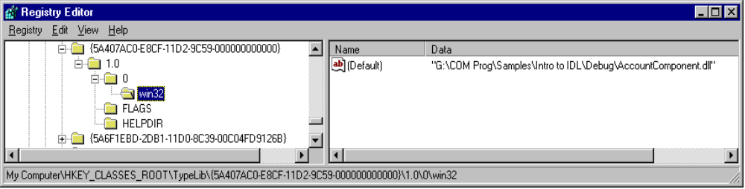
Registering a Type Library
In DLL server, modify DllRegisterServer()...
  Call LoadTypeLibEx() to register type library
… and DllUnregisterServer()
  Call UnRegisterTypeLib()
Alternatively, prepare a .reg file for use with RegEdit
  Several entries required under HKEY_CLASSES_ROOT\TypeLib key
Notes:
Page <number>
WNCOMPG-2 v1.5
Chapter 5, Introduction to IDL

Slide 19
Binding Type Library to a DLL Server
Create a resource script
  Add to Visual C++ project and rebuild
Use RegSvr32 to register server DLL
  Or select Register Control from Tools menu in Visual C++
Check with OLE/COM Object Viewer, or
Test with a simple Visual Basic client
// SimpleAccount.rc
1 TYPELIB "SimpleAccount.tlb"
Notes:
Page <number>
WNCOMPG-2 v1.5
Chapter 5, Introduction to IDL

Slide 20
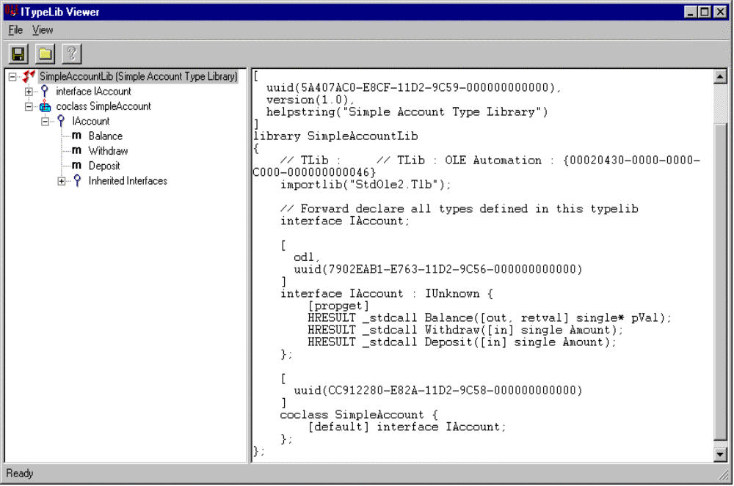
Using the OLE/COM Object Viewer
Can view type library and corresponding IDL
Notes:
Page <number>
WNCOMPG-2 v1.5
Chapter 5, Introduction to IDL

Slide 21


Summary
COM interfaces and objects can be described in IDL
  An interface requires an interface statement
  A COM object requires a coclass statement within a library statement
  All three statements require a uuid attribute
IDL is similar to C++ header, but it uses attributes to provide additional information to MIDL compiler
  Attributes must be enclosed in square brackets
  Most common attributes are uuid, in, out, retval and helpstring
MIDL compiler generates two key files from IDL file
  Header file (xxx.h)
  Interface GUIDs file (xxx_i.c)
If IDL file contains a library statement, MIDL compiler also generates a type library
  Binary tokenised form of IDL
  Makes COM object accessible to clients written in other languages
Notes:
Page <number>
WNCOMPG-2 v1.5
Chapter 5, Introduction to IDL

